Slide 1
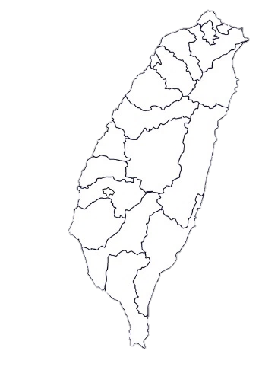
Go to Taiwan
talent
talent
Go to Taiwan
Go to Taiwan
Go to Taiwan
talent
talent
talent
talent
Go to Taiwan

Slide 2
Have you heard of the "Act for the Recruitment and Employment of Foreign Professionals" (Talent Law)?
The Act for the Recruitment and Employment of Foreign Professionals has been newly passed by the Taiwanese government on October 31, 2017 and will come into force on February 8, 2018.
The new rule offers many benefits in areas such as visas, residence, taxes and the entitlement of retirement pensions to foreign friends.
Welcome to develop your career in Taiwan.
2

Slide 3
The Features of our New Rule
Positive Elements For Foreigners
1. Facilitating the whole process from visa application to resident permit
2. Strengthening family closeness with new rules for spouses, minor children and parents.
3. The Taiwanese government provides access to its national health insurance system and its labor retirement pension system
3
Notes:
落實法規鬆綁建立友善環境提供線上平台倍增來臺人數

Slide 4
Do I qualify as a foreign professionals under the new rule?
Who is a foreign professional?
Specialized or technical work
School teachers
Sports coaches
Cram school teachers
Director/manager/executive of a business
Religious and artistic activities
Foreigners engaged in the following professional tasks in Taiwan:
4

Slide 5
What foreign professionals can do…
Working Permit and Scope in Taiwan
Artists can apply directly to the Ministry of Labor for a working permit
Cram school teachers can teach subjects other than foreign languages
Visa & Resident Permit
Visa for seeking employment allows recipients to stay in Taiwan for 6 months.
Foreigners who have obtained permanent resident permits, only need to enter into Taiwan once every 5 years.
5

Slide 6
Foreign Special Professionals Can Enjoy the Preferential Treatment Offered by Employment Gold Cards
Foreigners having special expertise, such as in technology, economics and culture, as designated by the Taiwan government.
Foreign special professionals are allowed to apply for employment gold cards combining working permit, residence permit and returning visas.
The working permit of foreign special professionals can be extended from 3 to 5 years.
Qualification
Benefits
Term Extension
6

Slide 7
Family Reunion for Foreign Professionals
Loosening the requirements for obtaining permanent resident permits for foreign professionals’ spouses and minor children
Adult children can directly apply for a working permit to the Ministry of Labor.
Parents of foreign special professionals are allowed to visit their children in Taiwan for one year.
7

Slide 8
Guarantees for Life in Taiwan
Access to Labor Retirement Pension
Foreign professionals obtaining permanent resident permits are entitled to apply for Taiwan’s labor retirement pension.
Full-time foreign teachers employed by public schools, once obtaining permanent resident permits, are allowed to choose to receive their retirement pensions monthly.
Access to Taiwan’s National Health Insurance Program
Spouses, minor children and adult children who are unable to live independently due to their physical or mental disabilities, once having obtained a resident permit, can participate in Taiwan’s national health insurance program.
Tax Preferences
Foreign special professionals need to pay only half of their originally calculated income taxes in the first three years working in Taiwan, provided that their annual income is above NT$ 3 million dollars.
8

